Slide 1
Taxi Management
MVC model

Slide 2
TABLE OF CONTENTS
01
04
About the MVC Model
Controller
02
05
Model
Pros & Cons
03
06
Viewer
Summary

Slide 3
ABOUT THE MCV MODEL
A software design pattern[1] commonly used for developing user interfaces that divides the related program logic into three interconnected elements. This is done to separate internal representations of information from the ways information is presented to and accepted from the user.

Slide 4
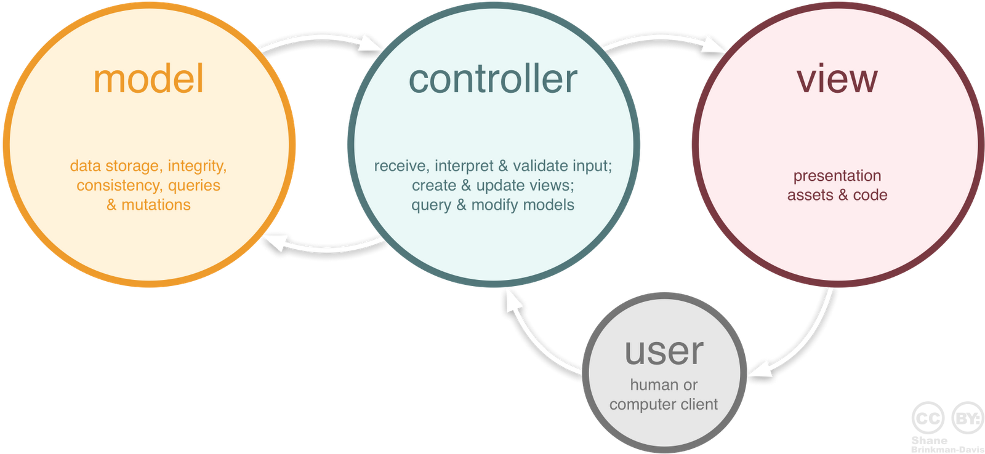
OUR TIMELINE

Slide 5
MODEL
The central component of the pattern. It is the application's dynamic data structure, independent of the user interface. It directly manages the data, logic and rules of the application.

Slide 6
VIEWER
Any representation of information such as a chart, diagram or table. Multiple views of the same information are possible, such as a bar chart for management and a tabular view for accountants.

Slide 7
CONTROLLER
Accepts input and converts it to commands for the model or view.

Slide 8
PROS & CONS
Simultaneous development
High cohesion
Low coupling
Code navigation
Multiple Representations
Ease of modification
Multiple views for a model
Notes:
Pros:
1. Best suitable for applications in which good chances are getting more business entities/ screens with new requirements, in future. New frames just fit into the existing pattern without hassle.
2. Good module design. Separate classes are kept for UI, Business Logic so code is clean and easy to maintain.
3. With different views provided, you can reuse same business entities into another software. As Business entities and views are not tightly coupled.
Cons:
1. Complex design pattern. It needs good understanding of the control flow among view, business entity and controller. Otherwise it will be difficult to debug the deffects.
2. If different teams are working on UI and Model classes, then they need to be in same pace of development.

Slide 9
SUMMARY
MVC is a model that is used a lot in programming. A well-developed MVC system will allow front-end, back-end development together on the system without interference, sharing, editing files while one or two parties are still working.

Slide 10
THANKS!
Does anyone have any question?
addyouremail@freepik.com
+91 620 421 838
yourcompany.com

